Slide 1

TERM-PROJECT iOS APP DATASET ANALYSIS UNSTRUCTURED DATA MANAGEMENT
Akhil Menon
DeepakRao Bandhakavi
Abhijeet Ray
Kushagra Sen
Aparna Sree

Slide 2
Goal
To understand the iOS dataset, analyze the database, prepare a variety of metrics and then design the front page of iOS app for a given business and for a given reviewer

Slide 3
Solution
Our solution focuses on providing advance analytics from iOS data to help existing users and business owners
We want to enable users to figure out few interesting trends and most happening places using iOS data.
We want to enable existing business owners to improve their services using analytics so that they can make important decisions regarding business expansion in new cities, countries.

Slide 4
Our MongoDB schema has the following collections: app_reviews , app_rankings , and app_release_notes.
Unique Index was created on store app id field from ranking collection to make sure that every app which goes into this collection has a store app id.
The first step is to create the collections that have indexes/constraints built in them. Here we create the constraints for collection review and index for ranking collection

Slide 6
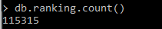

Slide 8
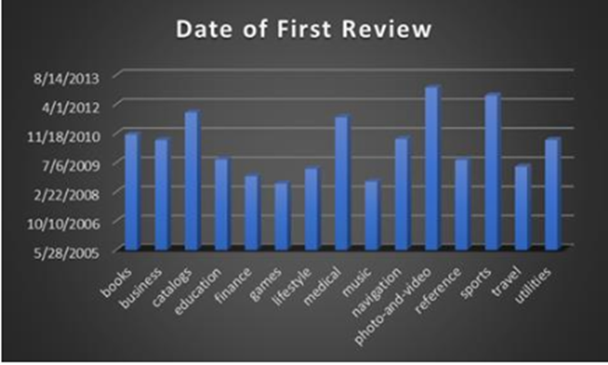
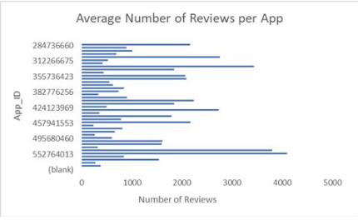
What is the date of the first review per app?
Explanation: On the review collection group on store_app_id and use min function to calculate the first review per app.
Command Used:db.review.aggregate([{ $group : { “_id” : “$store_app_id”, EarliestReviewDate: {$min: “$date”}}}])
What is the average number of reviews per app?
Explanation: On the review collection group on store_app_id and use average function to calculate the average number of reviews.
Command Used : db.review.aggregate([{$group:{“_id”:”$store_app_id” ,AverageReview:{$sum: 1}}}])

Slide 15
Neo4j: Graph Model
App
Reviewer
{id, reviewer_id,
user_apple_id,
username}
{ id, store_app_id}
GIVEN ON
GIVES
{ id,
store_app_id,
reviewer_id,
user_apple_id,
review_id,
title, body,
star_rating,
date,
user_reviews_url}
{ id,
store_app_id,
app_name,
rank_type,
category,
rank, date}
App_Rank
Review
BELONG TO

Slide 16
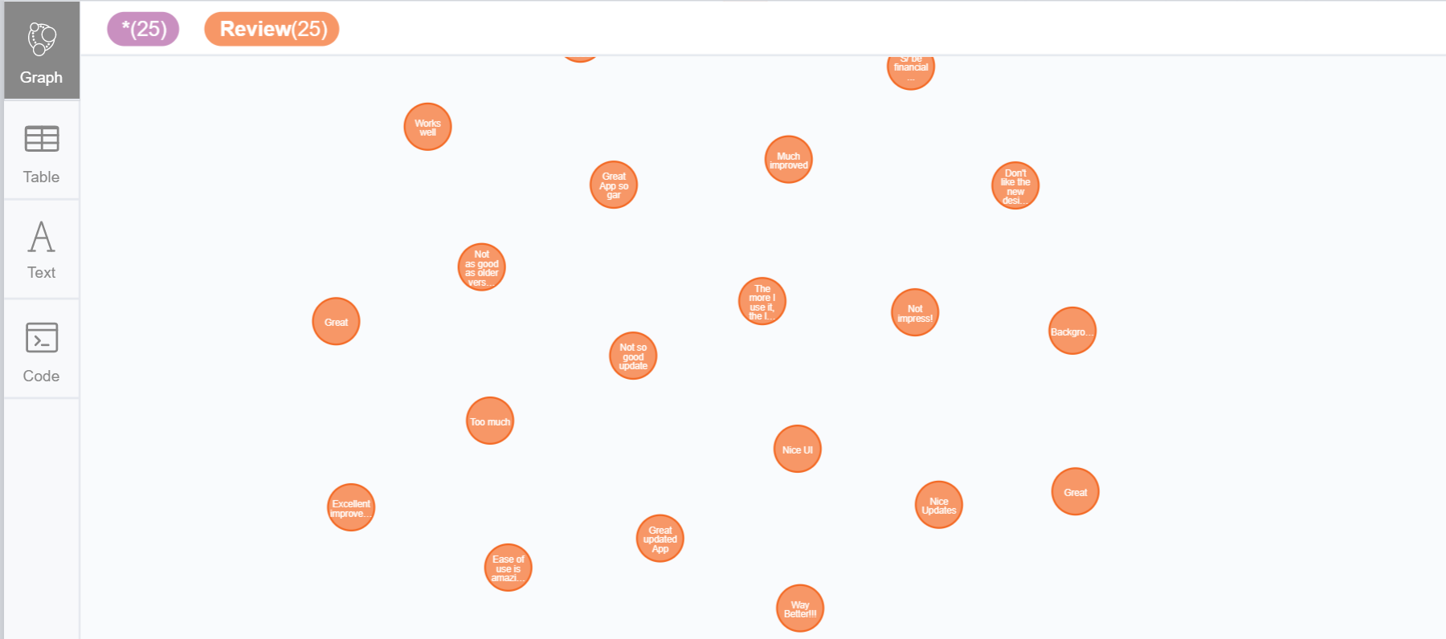
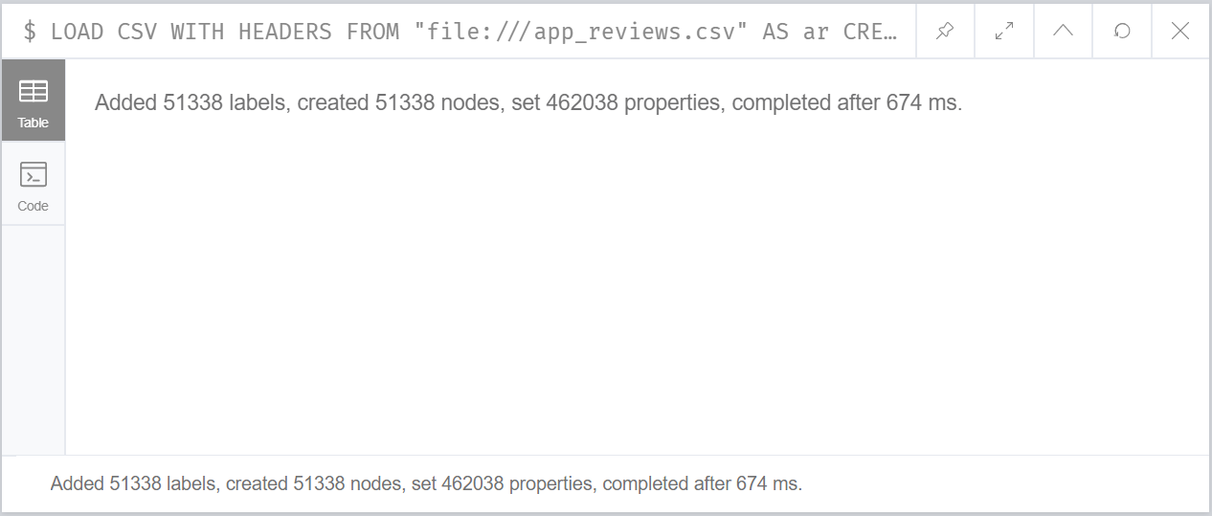

Slide 17
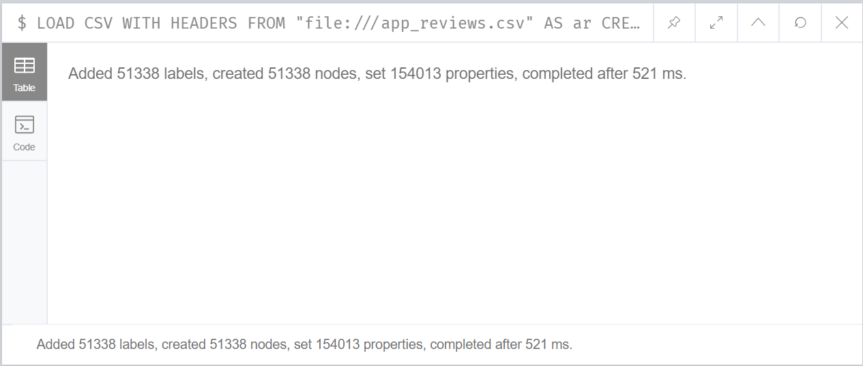
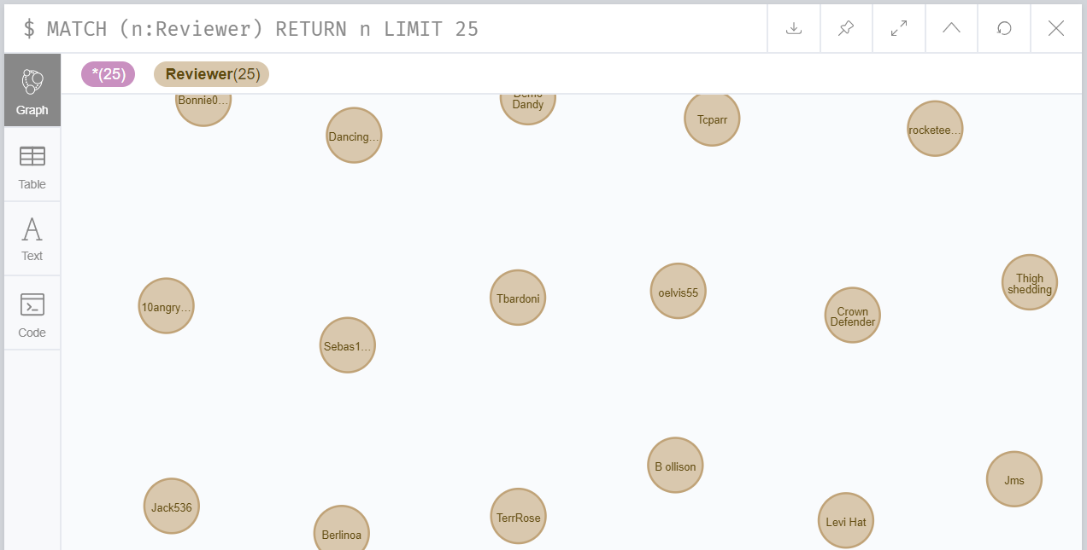

Slide 18
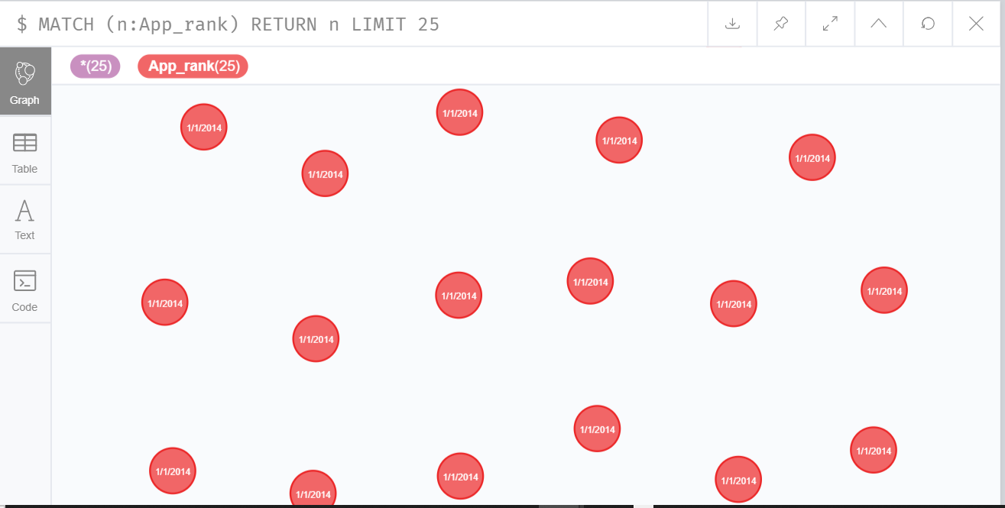

Slide 19

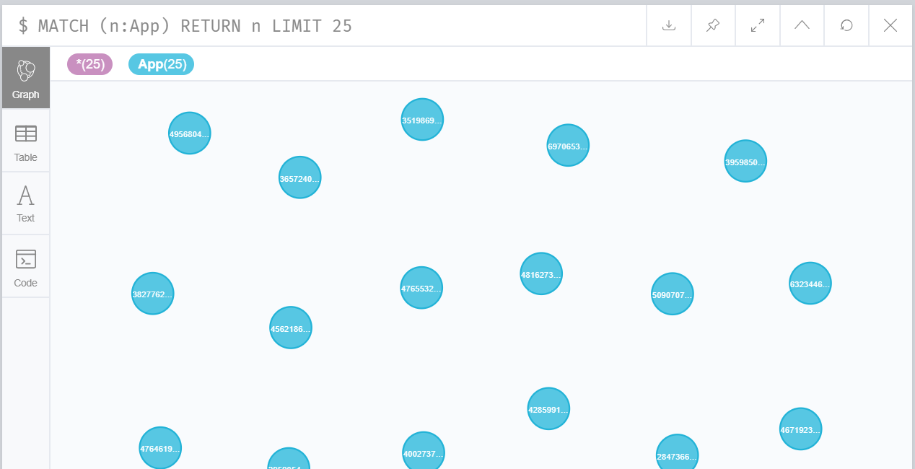

Slide 20
Data Cleaning:
MATCH (a:App)
WITH a.store_app_id AS appID, COLLECT(a) AS apps
WHERE size(apps) > 1
FOREACH (a in tail(apps) | DELETE a)
MATCH (ar:App_rank)
WITH ar.store_app_id AS appID, COLLECT(ar) AS apps
WHERE size(apps) > 1
FOREACH (ar in tail(apps) | DELETE ar)
MATCH (r:Reviewer)
WITH r.reviewer_id AS reviewerID, COLLECT(r) AS reviewers
WHERE size(reviewers) > 1
FOREACH (r in tail(reviewers) | DELETE r
Relationships
Interactions between nodes are termed as relationships. In our graph model, we have included four types of relationships

Slide 21
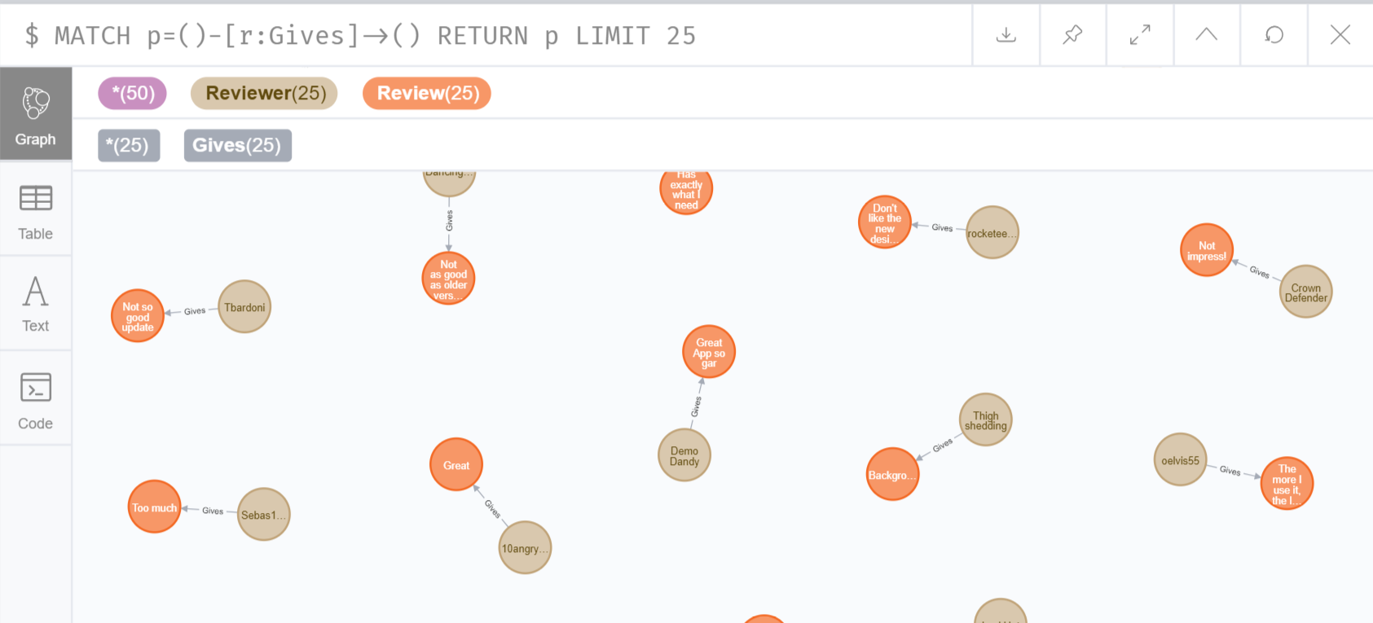

Slide 22
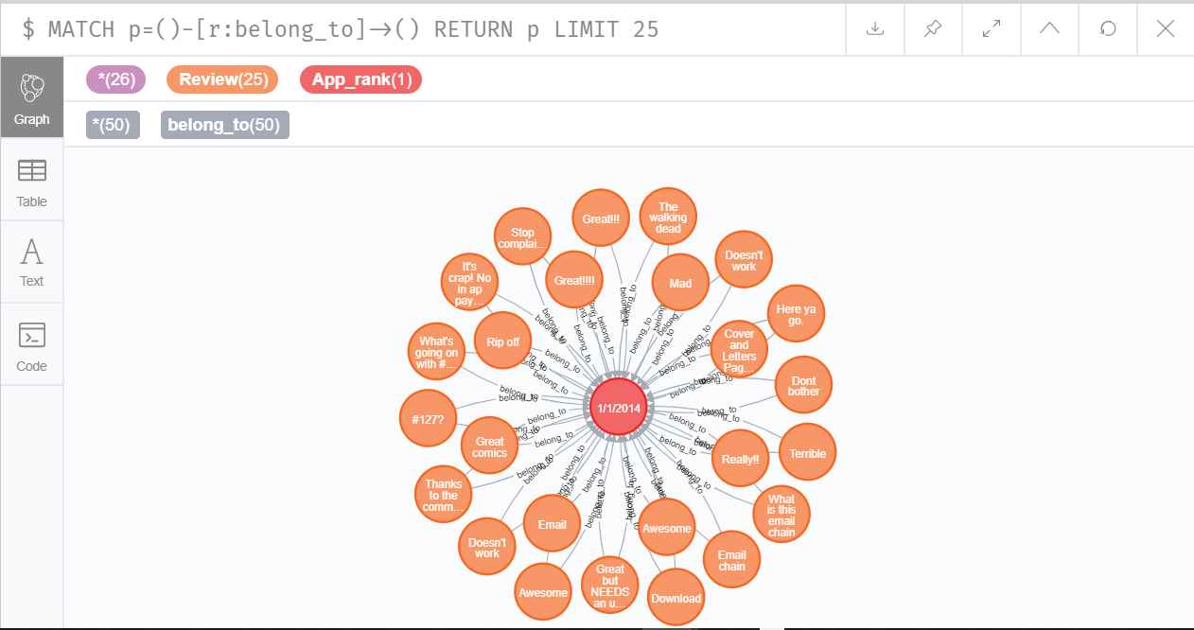

Slide 23
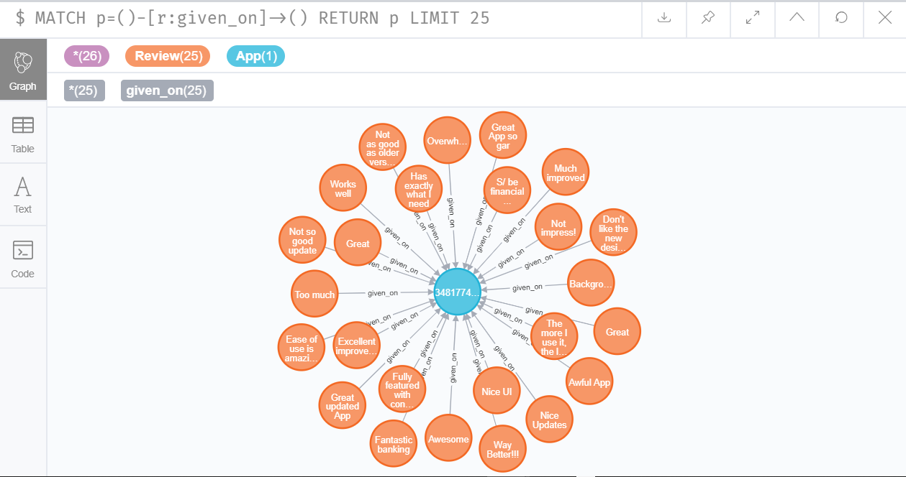

Slide 25
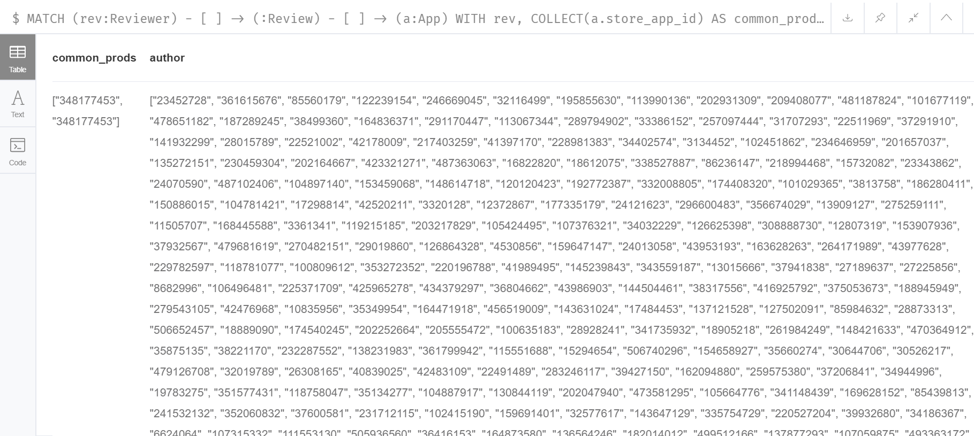
Neo4j Data Analytics
First Query –
Reviewers sometimes review as a mob (reviewing the common set of apps). Do you find this behavior in this dataset? Run the queries and derive the results??
MATCH (rev:Reviewer) - [ ] -> (:Review) - [ ] -> (a:App)
WITH rev, COLLECT(a.store_app_id) AS common_prods
WITH common_prods, COLLECT(rev.reviewer_id) as author
WHERE SIZE(author) > 1
RETURN common_prods, author

Slide 26
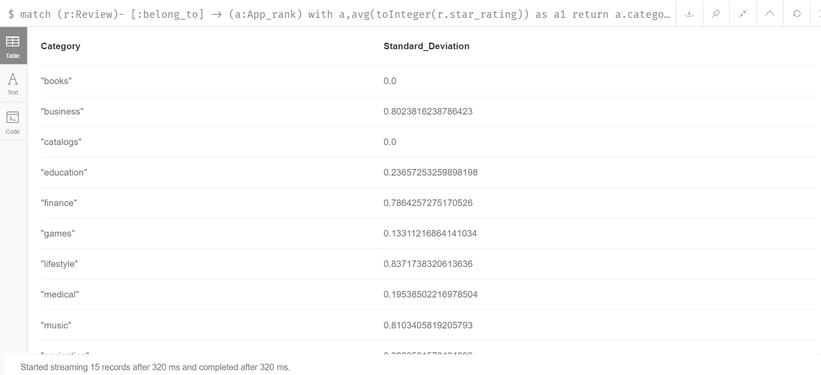
Second Query –
Match (r:Review)- [:belong_to] -> (a:App_rank) with a,avg(toInteger(r.star_rating)) as a1 return a.category as Category, stDevp(a1) as Standard_Deviation

Slide 27
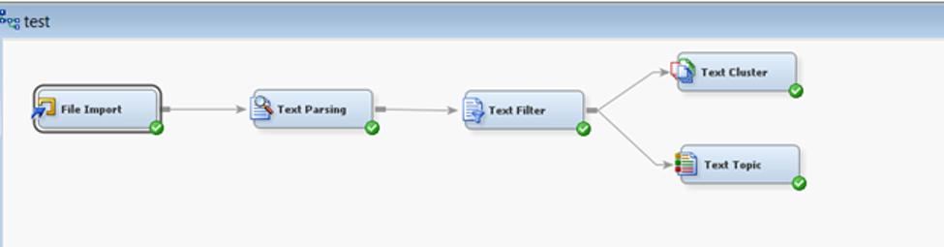
SAS Analytics
Above model is for predicting fake reviews

Slide 28
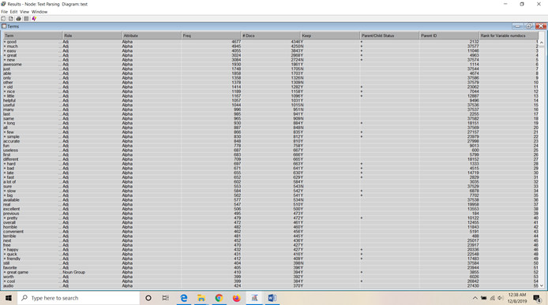
We parsed through the whole dataset and found out the words that were irrelevant for analysis.
So, in order to process our data, text parsing pallet helped us reduce our dataset by removing those type of words.
STEP 1: Text Parsing
We analyze the details of documents such as most frequently occurring term, the number of documents it has occurred in, the terms that are rarely used etc.
Example - The most frequently used terms- Good, Great, nice etc.

Slide 29
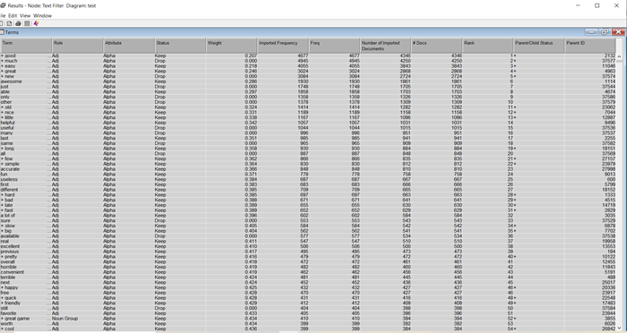
The text filter node is added to the text parsing node and is used to reduce the number of parsed terms to eliminate the extra information which is not useful for our purpose.
STEP 2: Text Filter
From the results, we can determine details like terms dropped, for example Much, Just, new, all, Same, many etc. are dropped as these terms have zero weight.

Slide 30
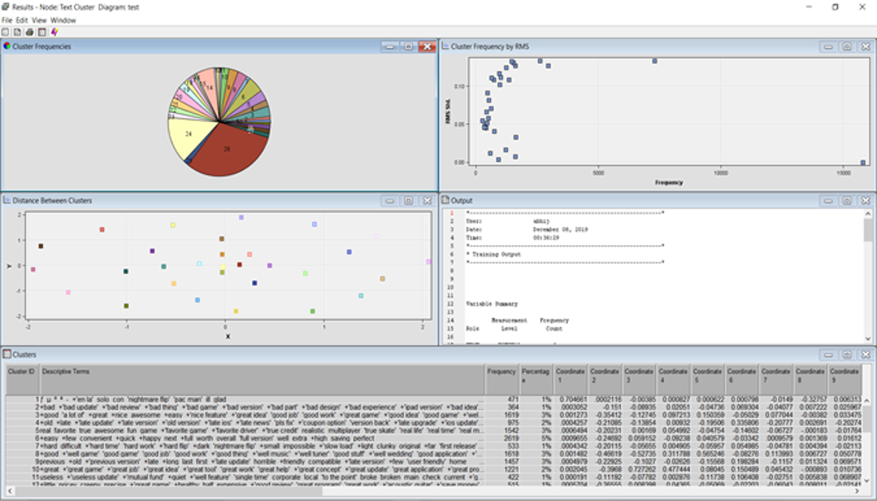
Text cluster is used to cluster the documents into sub parts on the basis of a descriptive term for those clusters
STEP 3: Text Cluster

Slide 31
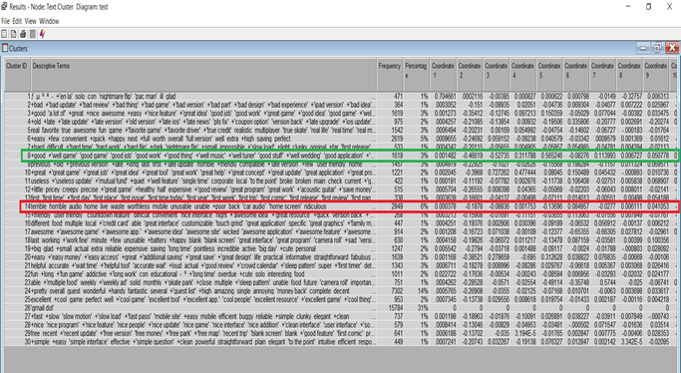
STEP 3: Text Cluster
We identify the groups where the word are extreme negative or extreme positive, the reviews that contain these set of words(cluster of words) are the ones which may potentially be made by a fake reviewer.
There are two clusters (8,14) with such extreme words and are the ones which may potentially be given by fake reviewers

Slide 32
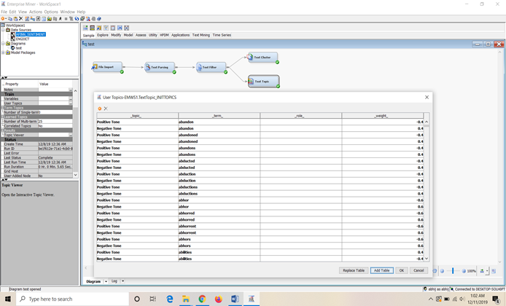
We have joined the Text Topic node to the text filter node which will enable us to combine the term into topics so that we can identify the reviews on the basis of these topics
STEP 4: Text Topic
The text topic node has divided the input into two tones- Positive and negative, it also shows topic ID, the number of terms that are present from the above table in the reviews and number of reviews they appear in.

Slide 33
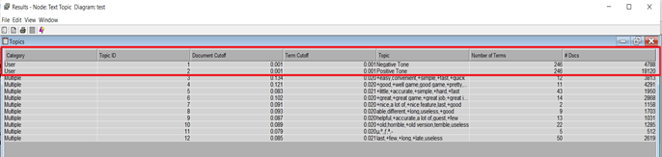
In topic viewer, we observed the above classification of topics. Top two classifications highlight the negative tone documents and positive tone documents. These two are the highly positive and negative documents which as per our assumption are fake reviews.

Slide 34

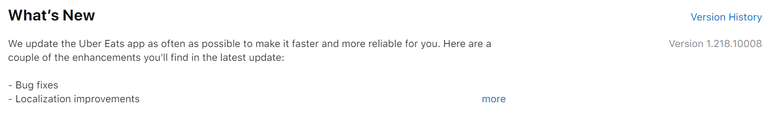

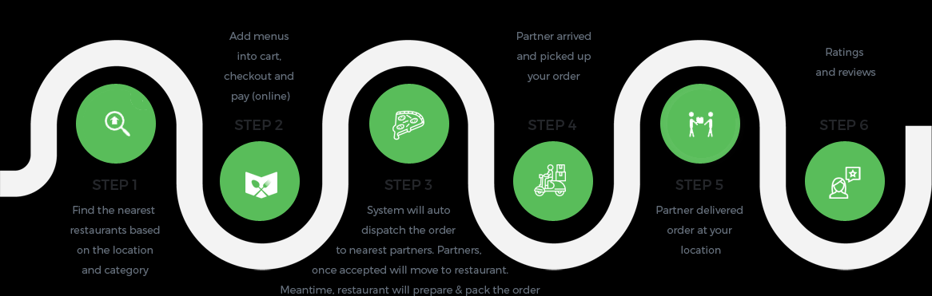
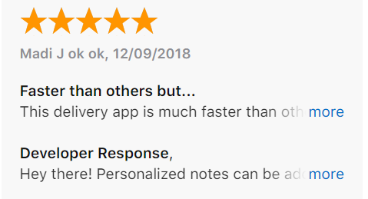
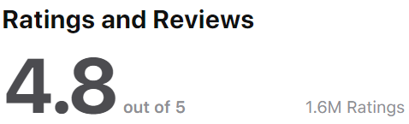

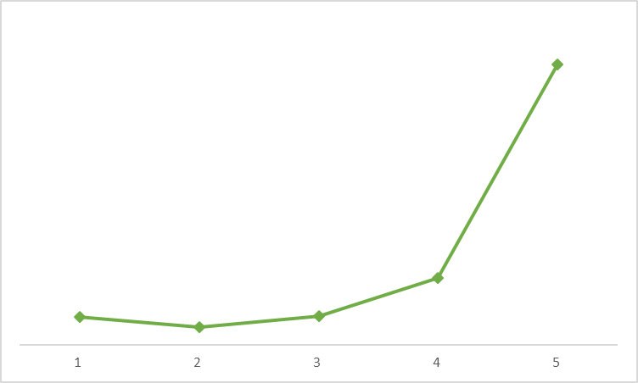
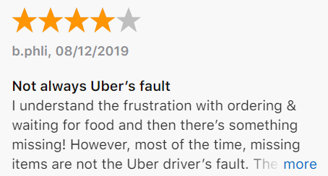
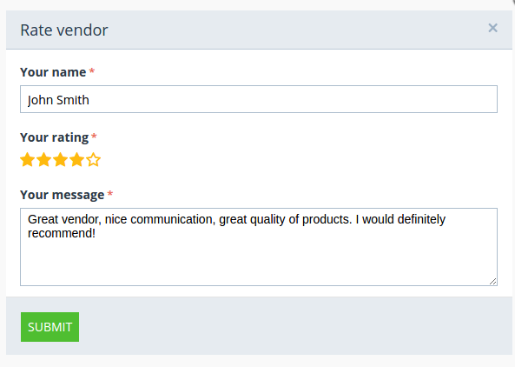
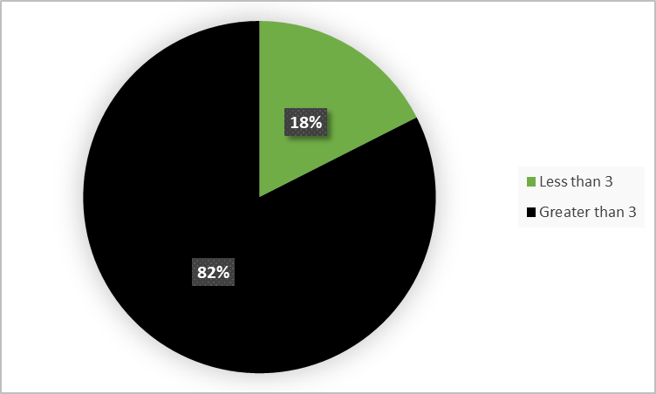
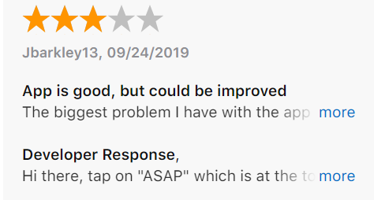
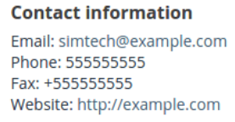
Business Page

Slide 35

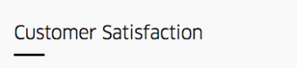
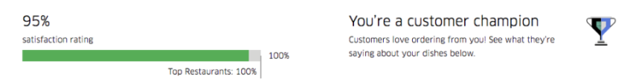


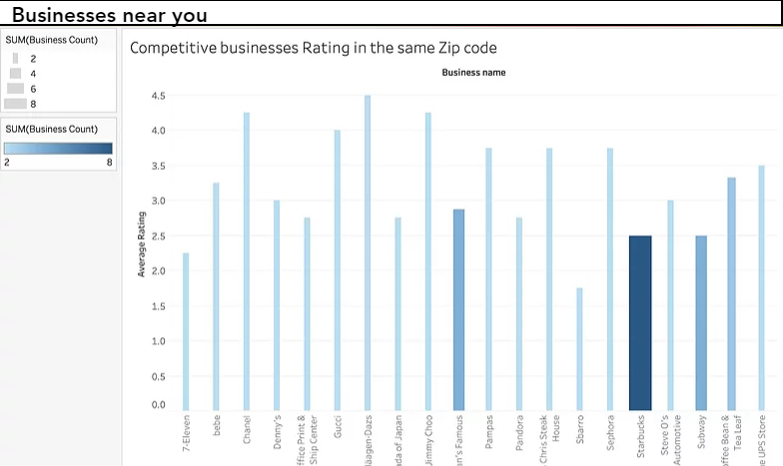
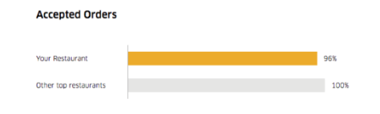
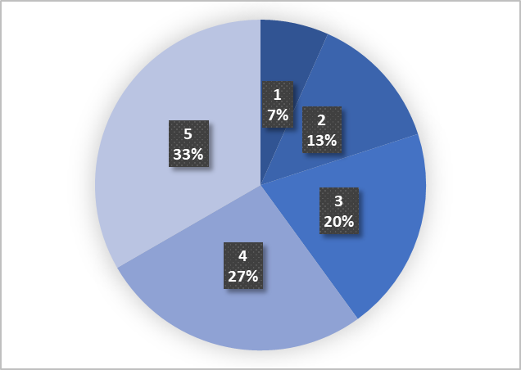
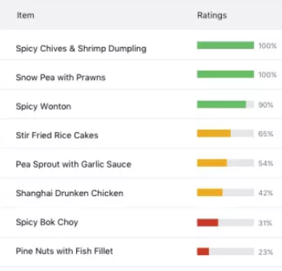
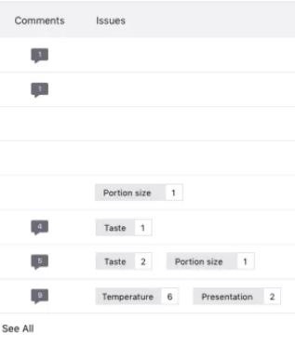
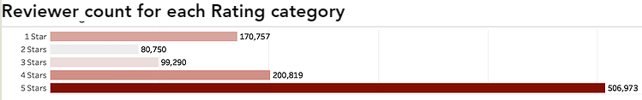
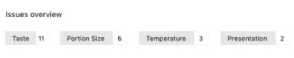
Ratings chart

Slide 36
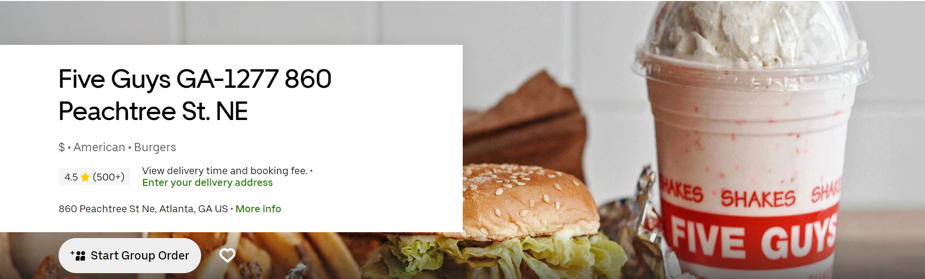

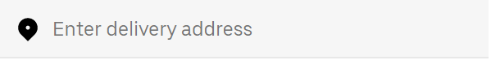
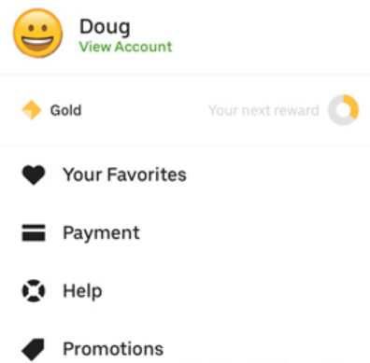
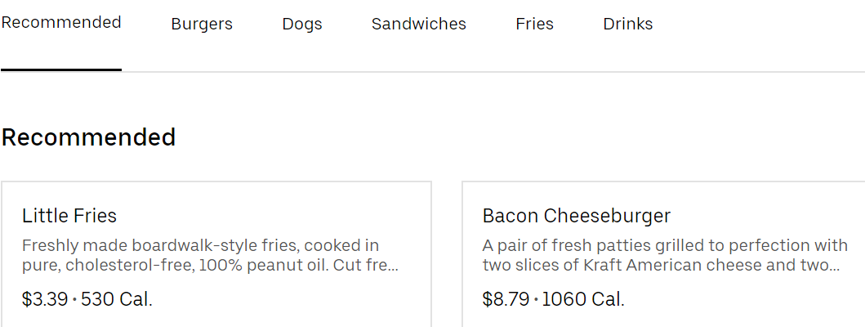
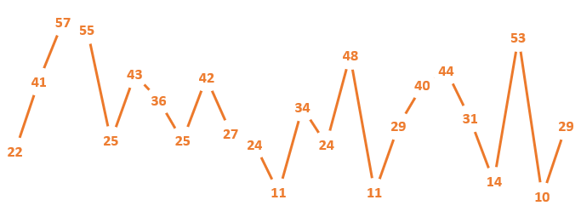
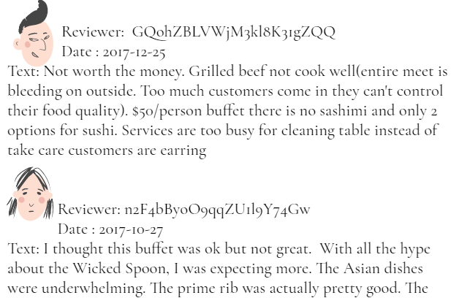

Currently open for delivery
Trend Across The Day

